Slide 1

N-Particle Spring Problem
The Unfinished Business with Euler-Cromer and N-particle Spring
Amani Ahnuar

Slide 2

Content
Equations, equations and equations …
Properties of model
Varying Timesteps dt
Let’s try to break Euler-Cromer
Wrap up

Slide 3
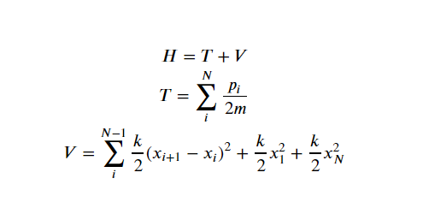
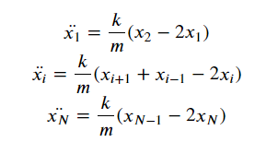
The Equations Involved
Hamiltonian Equations
Equations of Motions

Slide 4
Model Properties
Has N particles that works with N = 2, 3, 4, …
The particles are attached to a spring in series and the particles at the ends are attached to a hard wall
The purpose of this model is to show:
Conservation of total energy within system
The capabilities of Euler-Cromer algorithm with different timesteps

Slide 5

Basic Example
This is a model of 3-particle system with the following properties:
Time is from 0 to 50
All particles are at resting position (zero displacement) and no initial velocity except particle-1
Chosen timestep, dt is 0.01

Slide 6
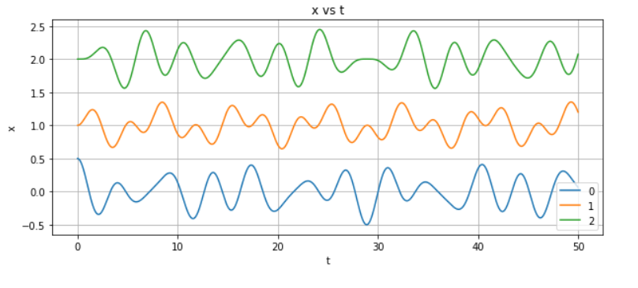
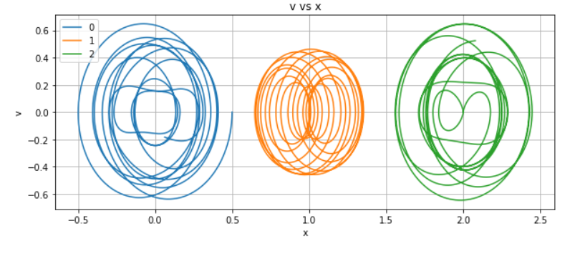
Phase Diagram
Displacement against Time

Slide 7
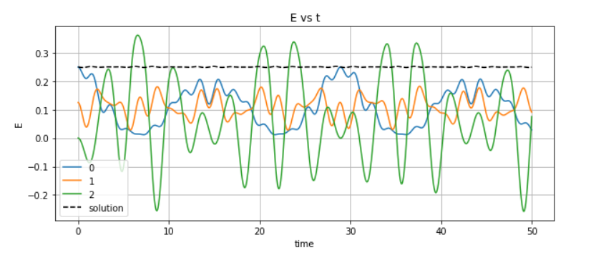
Energy
The interesting part is where the energy diagram is at. It shows how well Euler-Cromer has the energy conservation property in its algorithm. As we can see, the total energy is somewhat a tiny bit wiggly if not perfectly flat.

Slide 8
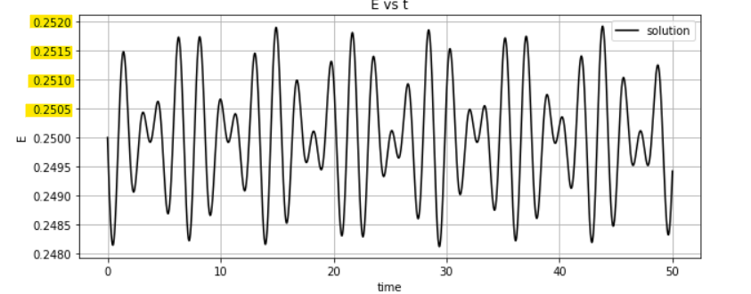
Zooming in to its scale, we can see how it “wiggles”. It seems significant but the actual value is not that bad.

Slide 9
Varying Timesteps
Now, we will try to see how varying timesteps affects the energy curve. For this sake of model, we will stick with these properties:
N = 10
Time from 0 to 50
Initial condition is set on particle-1 with +1 displacement and 0 velocity
We will vary from 1, 0.1, and 0.01

Slide 10
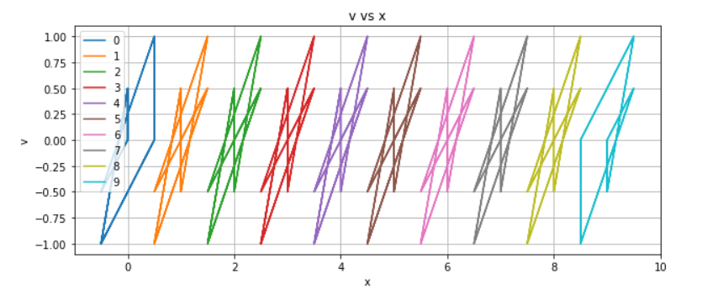
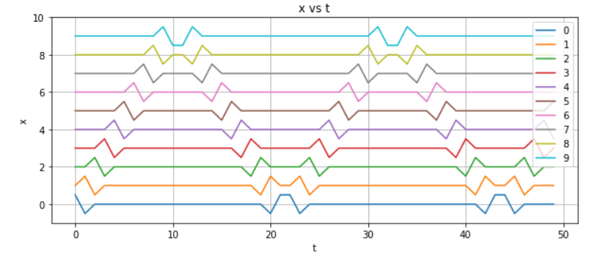
dt = 1
With dt=1, there are 50 iterations from 0 to 50

Slide 11
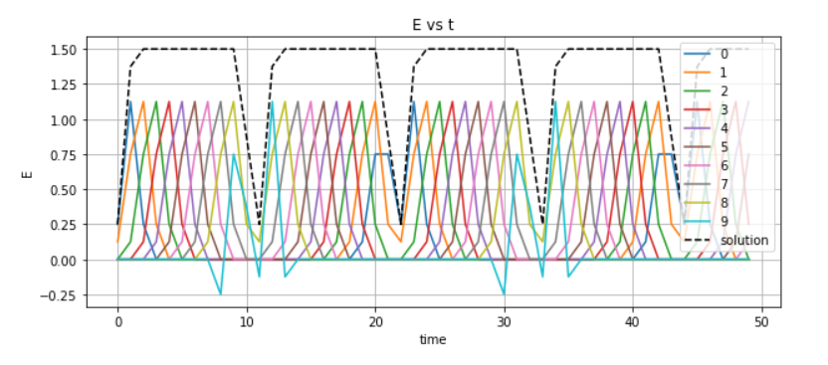
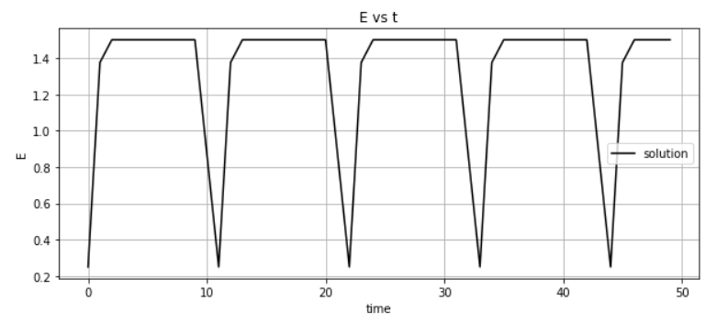
Here the difference between scale in the energy diagram is 2e-1

Slide 12
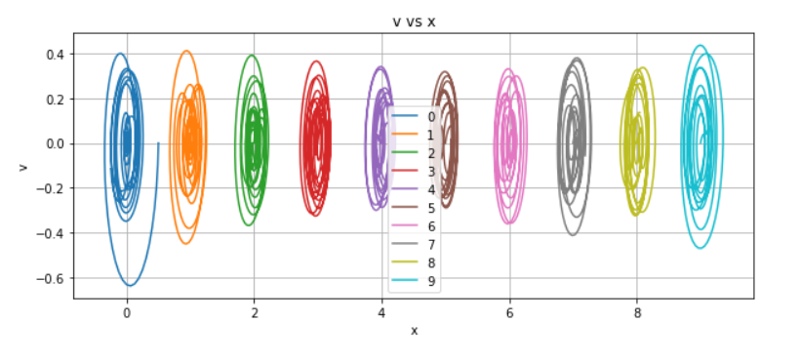
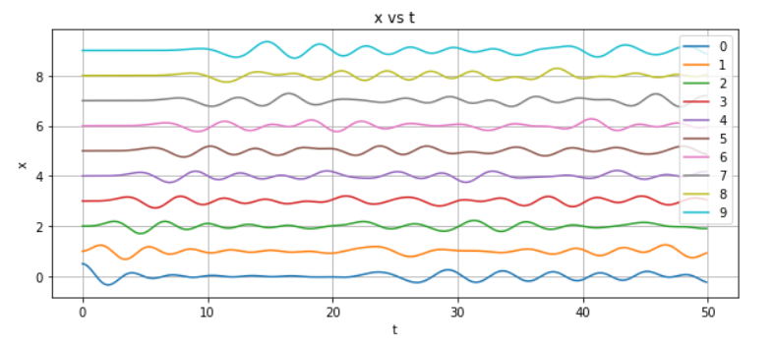
dt = 0.1
With dt=0.1, there are 500 iterations from 0 to 50

Slide 13
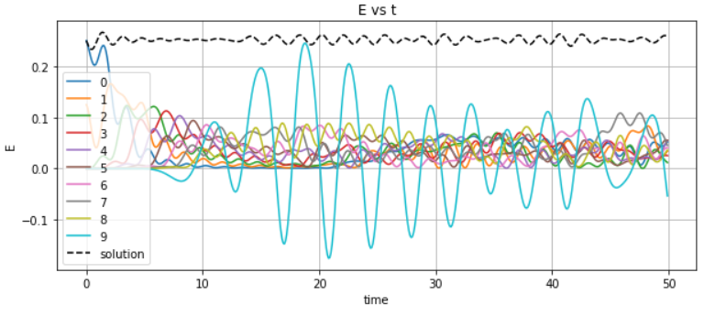
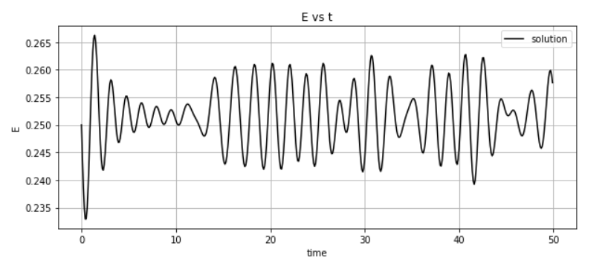
Here the difference between scale in the energy diagram is 5e-2

Slide 14
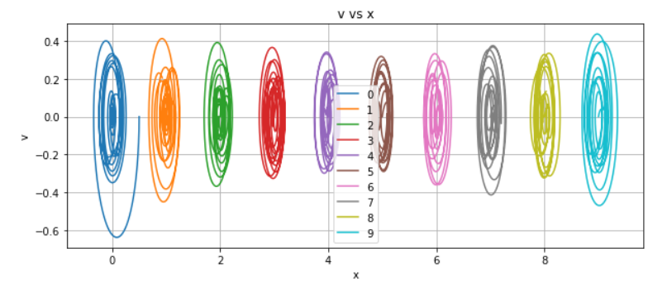
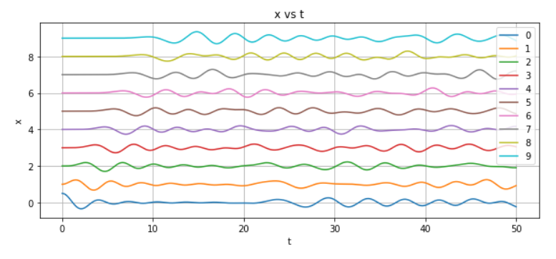
dt = 0.01
With dt=0.01, there are 5000 iterations from 0 to 50

Slide 15
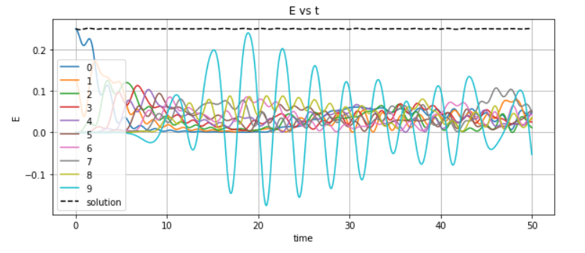
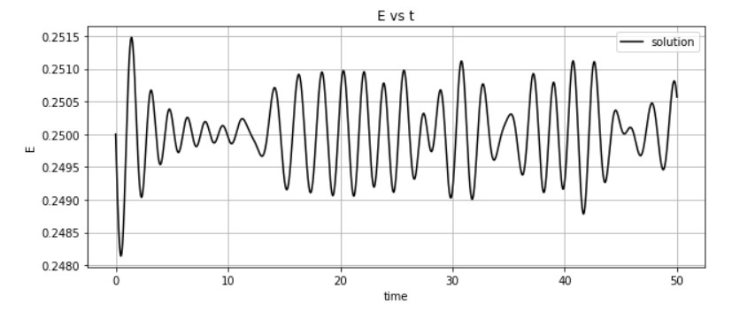
Here the difference between scale in the energy diagram is 5e-4

Slide 16
dt = 0.01
With dt=0.01, there are 5000 iterations from 0 to 50

Slide 17
Here the difference between scale in the energy diagram is 5e-4

Slide 18
Breaking the Euler-Cromer
I have put up two timesteps that I try it out to see at what point the Euler-Cromer will not have a good enough total energy curve that its average might not look accurate. I did one with dt = 1.01 and another with dt = 1.015

Slide 19
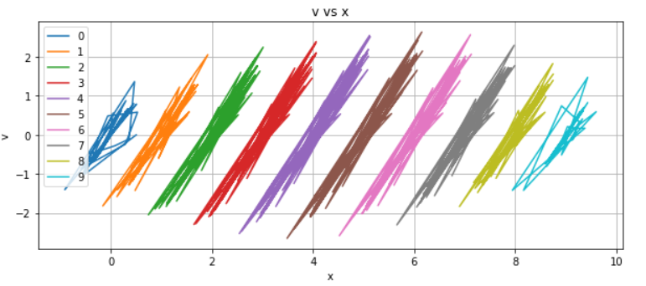
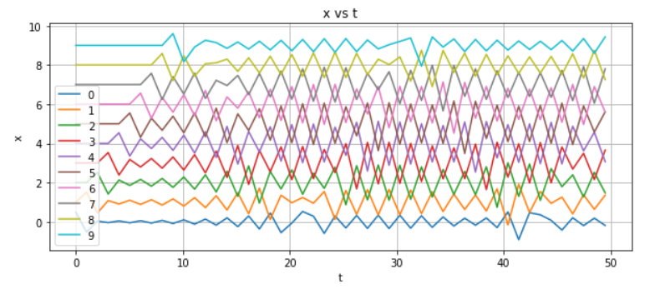
dt = 1.01
With dt=1.01, there are 49.5 iterations from 0 to 50

Slide 20
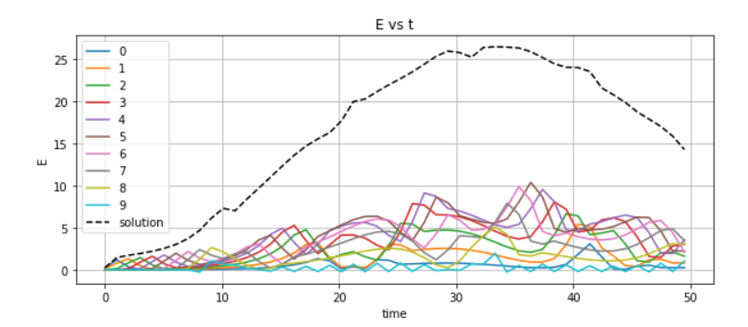
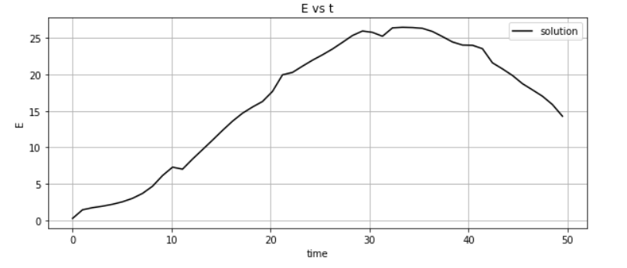
Here the difference between scale in the energy diagram is just the same as the one with all the energy of each particle has

Slide 21
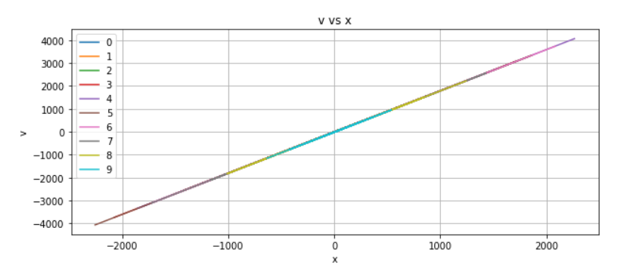
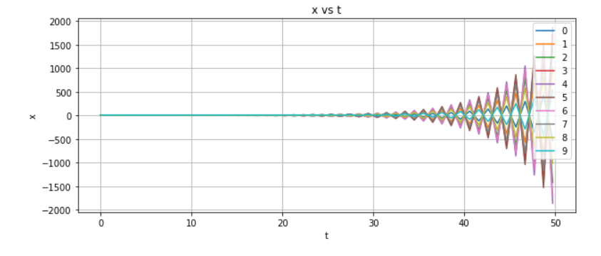
dt = 1.015
With dt=1.015, there are iterations from 0 to 50

Slide 22
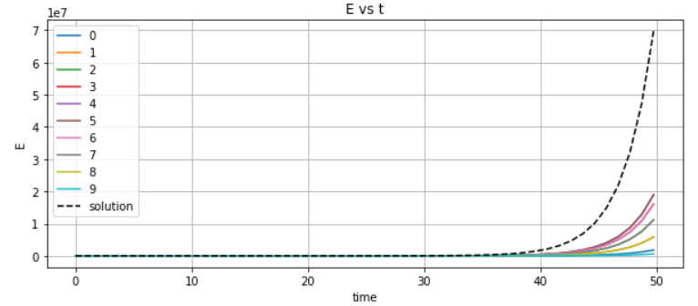
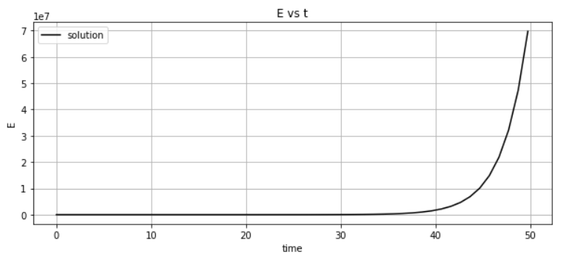
Here the difference between scale in the energy diagram is just the same as the one with all the energy of each particle has too

Slide 23
Conclusion
Euler-Cromer has been proven to conserve energy well
With small change of timestep, we can get large precision improvements.
The algorithm can break with large enough timestep that it will be unable to conserve energy properly and the phase diagram cannot make a good loop with the energy diagram has increase of energy in system

